Slide 1
Machine Learning & Combinational Optimization
2021/04/20

Slide 2
Content
Applications of CO
A
Methods for CO
B
Proposed DRL-SFCP Model
C
Performance Simulation
D
Conclusion and Future work
E

Slide 3
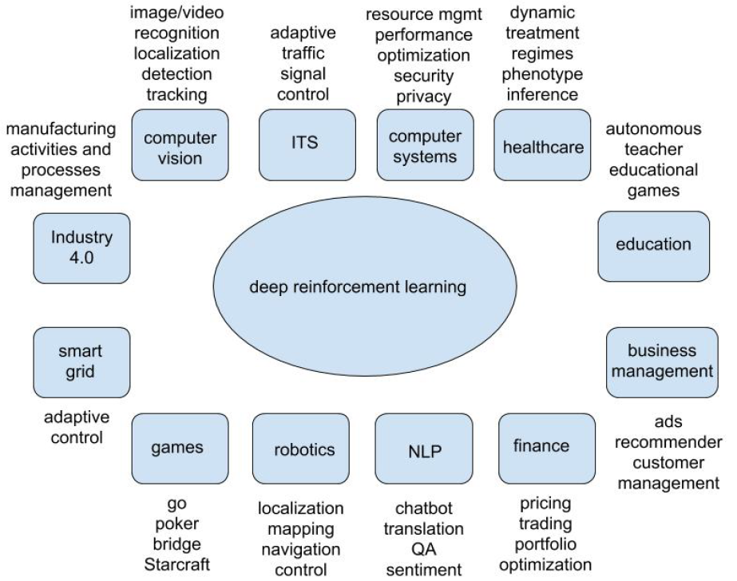
Applications
Yuxi Li et al. “Deep Reinforcement Learning: An Overview”. arXiv, 2018

Slide 4
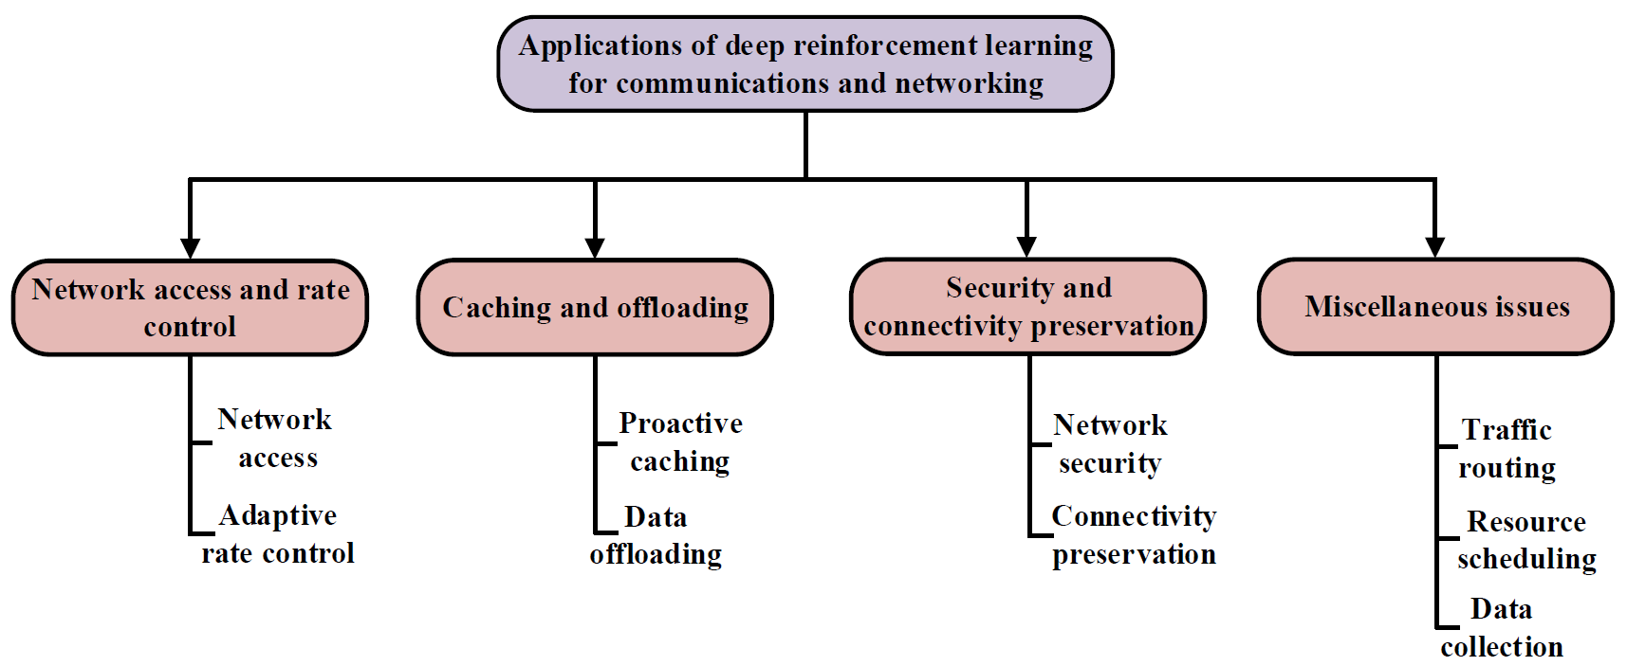
Applications
Nguyen Cong Luong et al. “Applications of Deep Reinforcement Learning in Communications and Networking”. IEEE Commun. Surv. Tutor. 2018

Slide 5
Methods
Exact approach
not applicable for large problems
Enumeration
to reduce the search depth
heuristic search needs a heuristic function
branch-and-bound needs a bounding function
Approximate approach
finds an approximate solution usually in polynomial time
Heuristic approach
can find a solution quickly, however, without exactness guarantee
local search methods, like genetic programming, evolutionary methods
usually rely on manual heuristics
hard to tune when and where to apply heuristics
ML-based approach
construct solutions from problem specification with help of ML ALGO
End-to-end
ML + X
Others

Slide 6
GNN & CO
Travelling Salesman Problem (TSP)
Vehicle Routing Problem (VRP)
Task
Provided a list of cities and the distances between each pair of cities, find an route to return to the origin city
Constraint
each city is visited exactly once
Objective
minimizes the tour length

Slide 7
GNN & CO
Travelling Salesman Problem (TSP)
Vehicle Routing Problem (VRP)
Task
A single capacitated vehicle deliveres items to multiple customer nodes
Constraint
The vehicle must return to the depot to pick up additional items when it runs out
depot
Objective
Minimize the total vehicle distance or average service time
depot: all beginning and ending at a given node

Slide 8
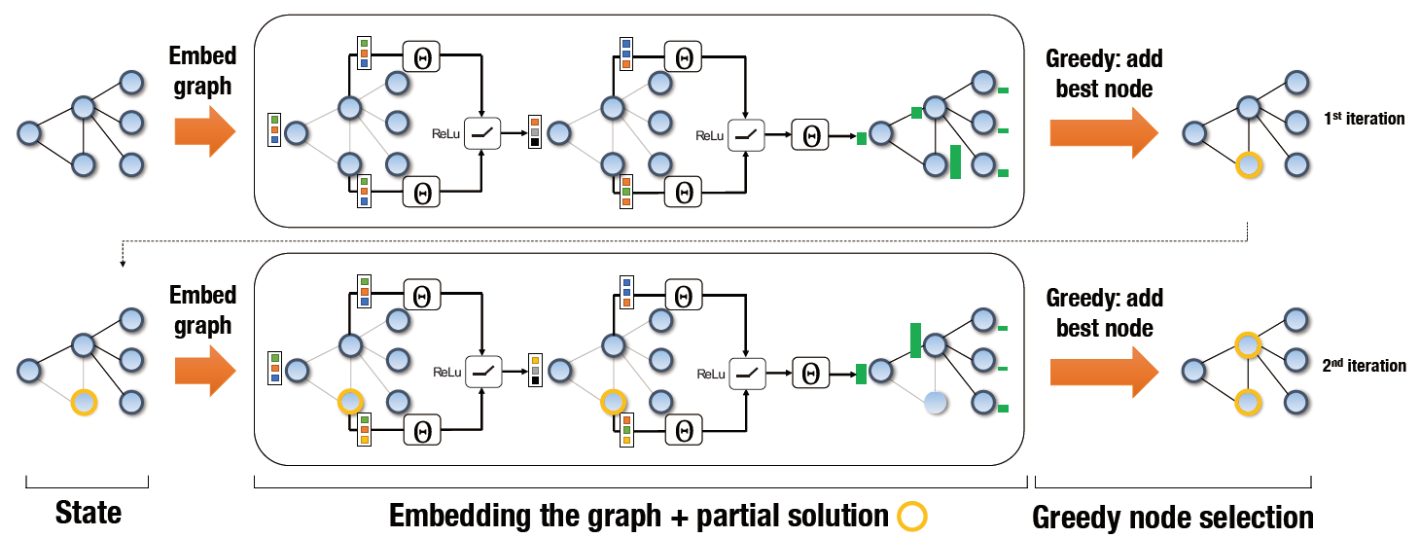
S2V-DQN
State
Graph Embedding
Greedy Selection
Structure2Vec
unselected: x=0
selected: x=1
Hanjun Dai et al. “Learning Combinatorial Optimization Algorithms over Graphs”. In NeurIPS, 2017

Slide 9
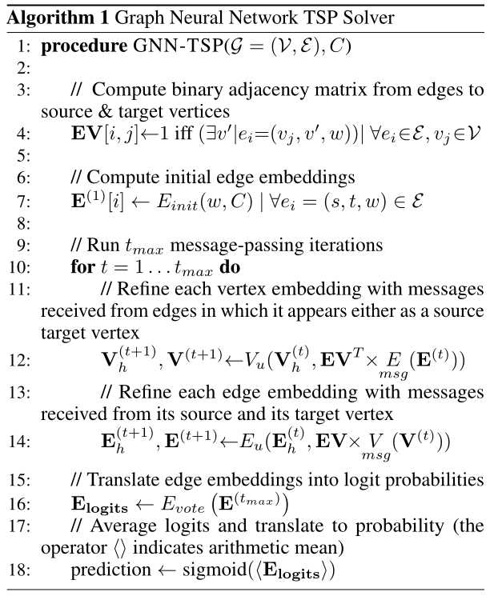

GNN-TSP
V
vertex-to-vertex adjacency matrix
E
edge list matrix
source vertices
target vertices
weight
EV
edge-to-vertex adjacency matrix
LOOP
MIP
V
EV
Edge Probs
RNN
V
MIP
E
RNN
E
Prediction
Marcelo Prates et al. “Learning to Solve NP-Complete Problems: A Graph Neural Network for Decision TSP”. In AAAI, 2019

Slide 10
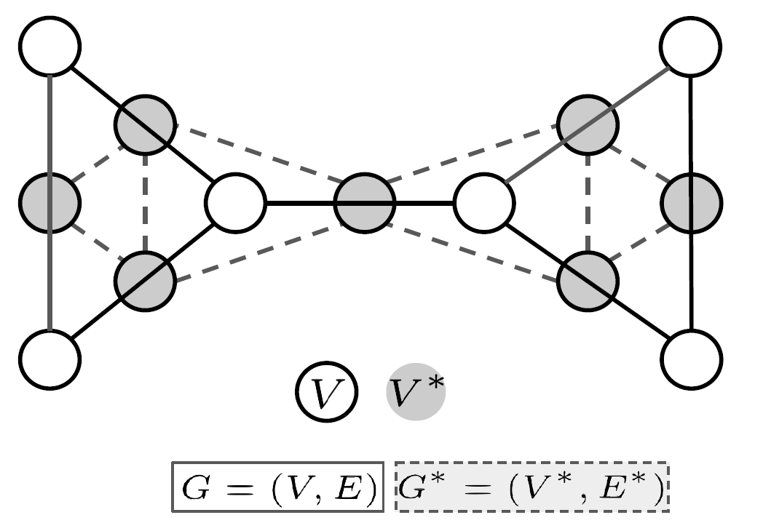
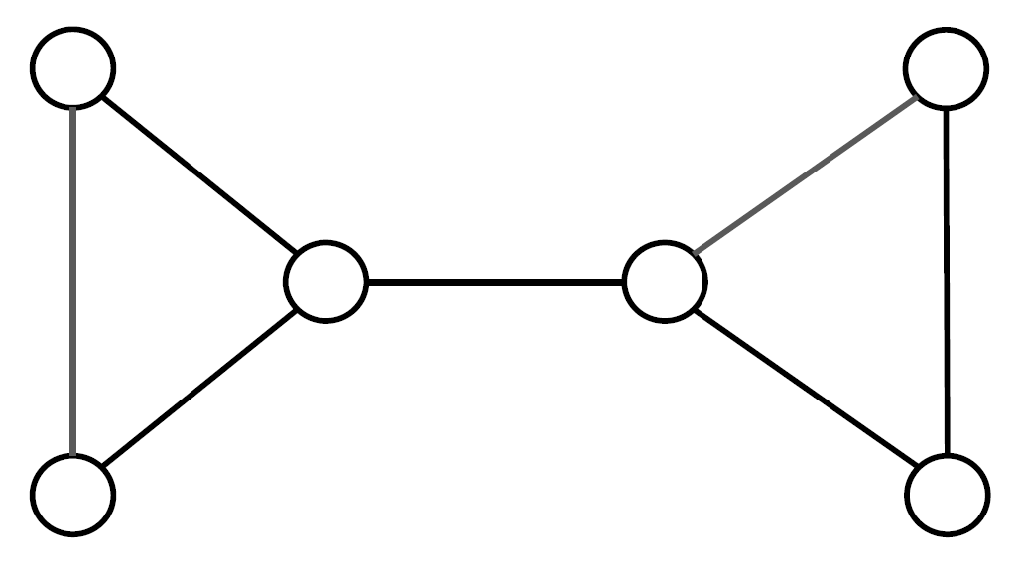
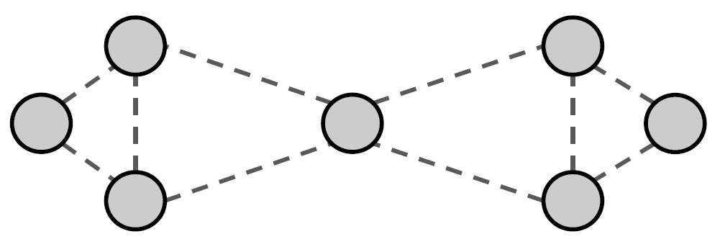
Model
Line graph: Edge-to-Vertex Dual
Each edge in primal graph corresponds to node in line graph
Iddo Drori et al. “Learning to Solve Combinatorial Optimization Problems on Real-World Graphs in Linear Time”. arXiv, 2020
10
Notes:
The physical network and SFC requests are considered as the environment. Intuitively, the state includes the current physical network features and the SFC request demands. The action is actually one of the physical nodes to accommodate one VNF. Primarily, we employ a customized neural network as the agent to make placement decisions. According to the deployment result, the calculated reward is returned to award or punish the agent.

Slide 11
Model
Line graph: Edge-to-Vertex Dual
Each edge in primal graph corresponds to node in line graph
Two nodes in line graph are connected if corresponding edges in primal graph share a node.
Edge weights in primal graph become node weights in line graph.
Iddo Drori et al. “Learning to Solve Combinatorial Optimization Problems on Real-World Graphs in Linear Time”. arXiv, 2020
11
Notes:
The physical network and SFC requests are considered as the environment. Intuitively, the state includes the current physical network features and the SFC request demands. The action is actually one of the physical nodes to accommodate one VNF. Primarily, we employ a customized neural network as the agent to make placement decisions. According to the deployment result, the calculated reward is returned to award or punish the agent.

Slide 12
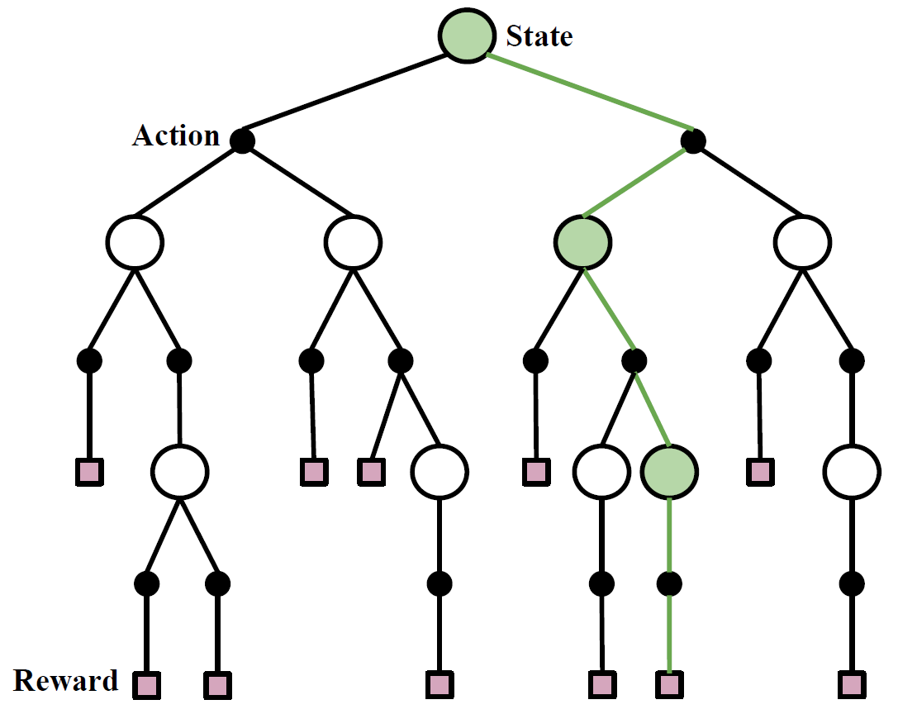
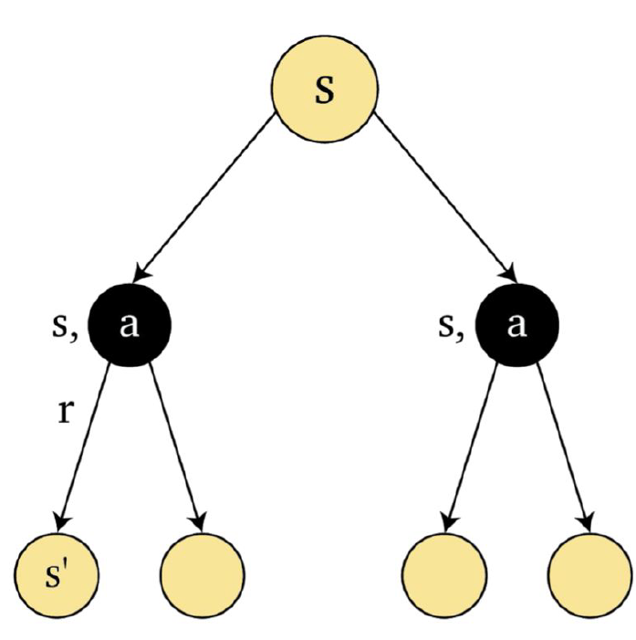
S2V-DQN
Combinatorial optimization as a single player game
Traversing a path
from the root
to a leaf node
Solution
states: nodes represent
actions: black nodes
Iddo Drori et al. “Learning to Solve Combinatorial Optimization Problems on Real-World Graphs in Linear Time”. arXiv, 2020

Slide 13
S2V-DQN
Combinatorial optimization as a single player game
represented by root node, may be
empty set,
a random state,
other initial state.
Initial state
Each path from root to a leaf consists of moving between nodes (states) along edges (taking actions) reaching a leaf node (reward).
Actions
adding or removing a node or edge
Reward (or cost)
value of solution
for example sum of weights or length of tour
Iddo Drori et al. “Learning to Solve Combinatorial Optimization Problems on Real-World Graphs in Linear Time”. arXiv, 2020

Slide 14
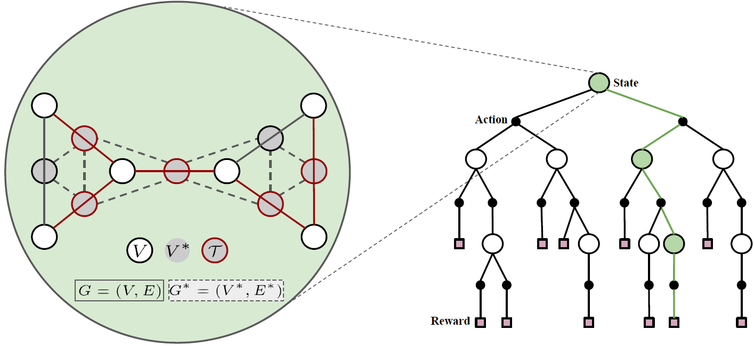
S2V-DQN
State
Iddo Drori et al. “Learning to Solve Combinatorial Optimization Problems on Real-World Graphs in Linear Time”. arXiv, 2020

Slide 15
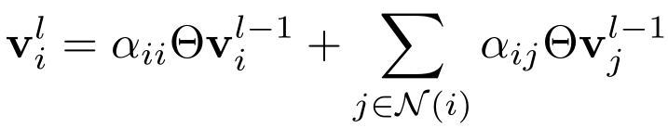
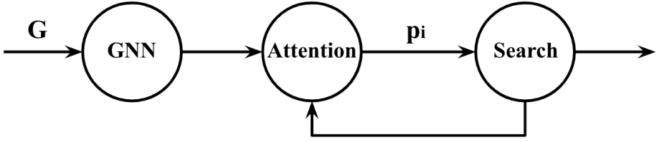
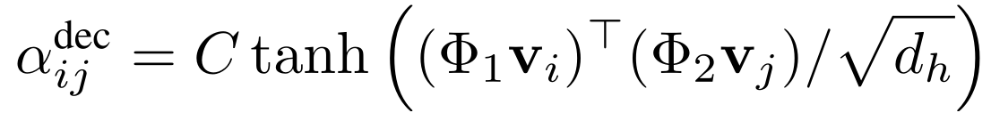
GNN & CO
Neural Networks
TSP
Pointer Network
Hierarchical Architecture
Encoder
GAT
Vector Context
Attention
Decoder
SoftMax -> Prob
Iddo Drori et al. “Learning to Solve Combinatorial Optimization Problems on Real-World Graphs in Linear Time”. arXiv, 2020

Slide 16
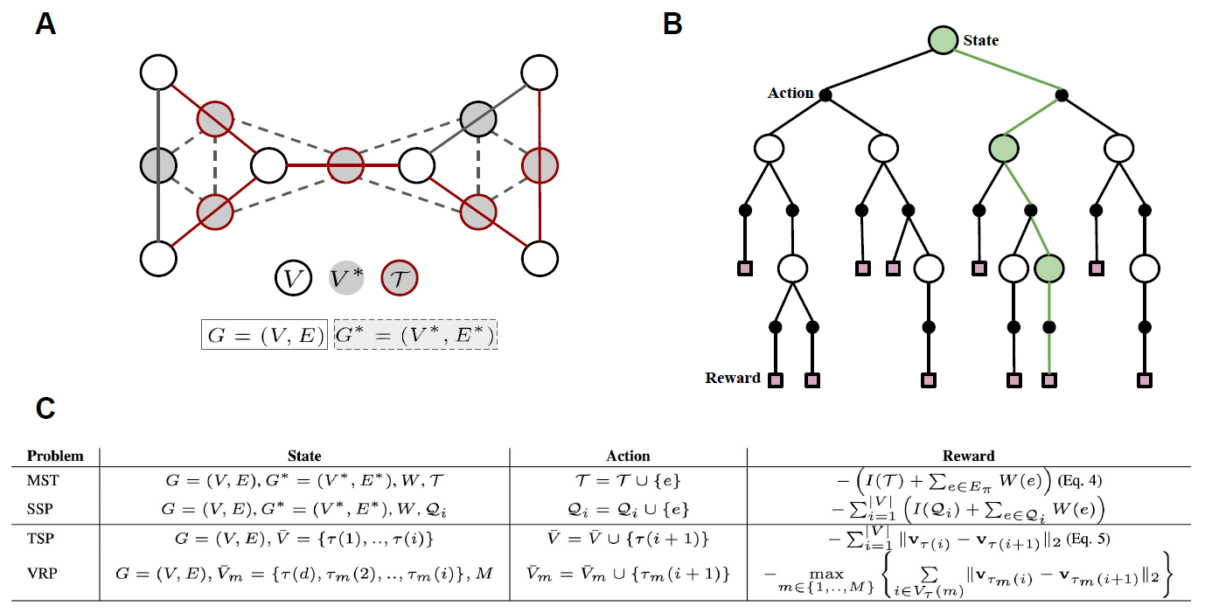
S2V-DQN
Unified Framework
Iddo Drori et al. “Learning to Solve Combinatorial Optimization Problems on Real-World Graphs in Linear Time”. arXiv, 2020

Slide 17
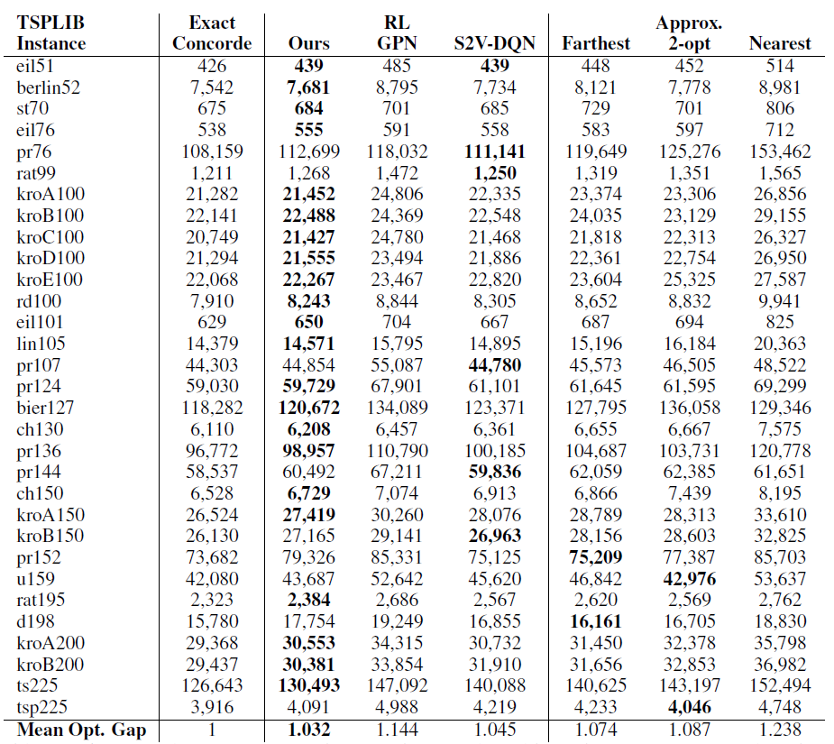
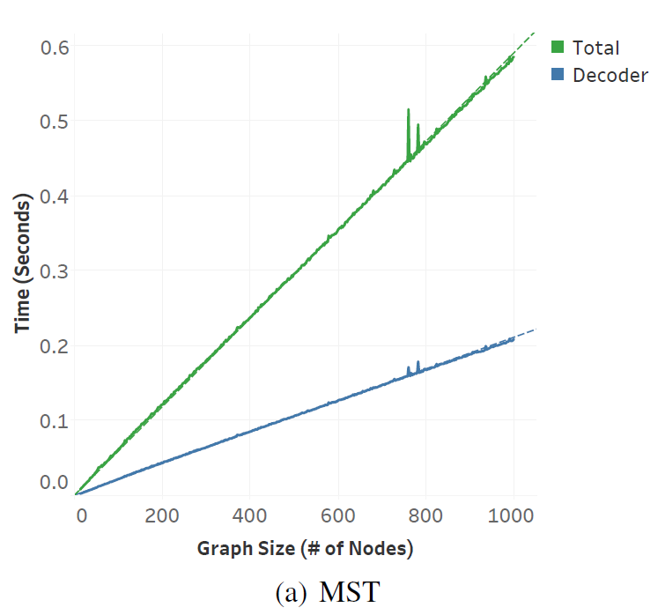
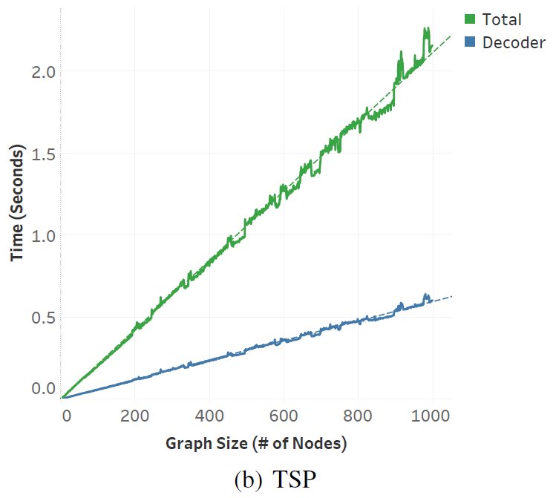
Evaluation
Notes:
Advantage actor-critic is an efficient training method for discrete action space. Both action and critic are composed of the aforementioned neural network but have disparate output. The state, including the features of the current physical network and VNF being placed, be input into the actor network. The agent selects the action based on action distribution, and the environment returns the reward. Meanwhile, we can obtain a value estimating the state after the same state is input into the critic network. Then, with the help of reward and this value, the Temporal error can be calculated. Finally, We use Cross entropy error and Mean squared error to optimize the actor and critic, respectively.

Slide 18
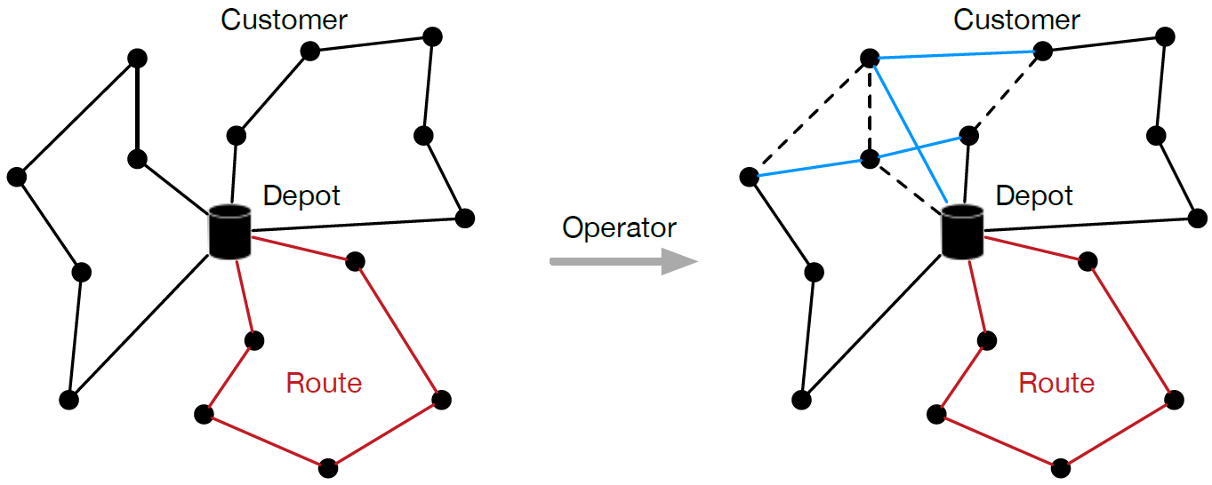
Iterative
Solution
Operator
New Solution
Route
Route
Route
improve or perturb
Route
Route
Route
intra-route
inter-route
Hao Lu et al. “A Learning-based Iterative Method for Solving Vehicle Routing Problems”. In ICLR, 2020

Slide 19
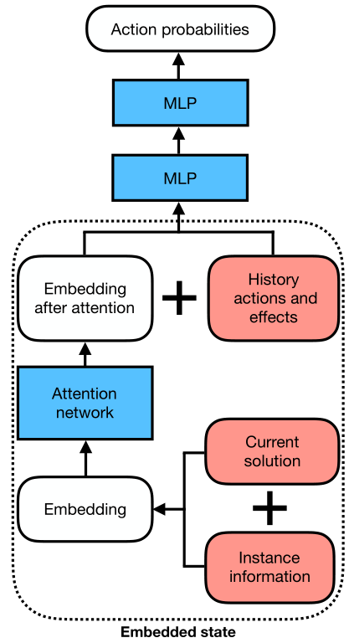
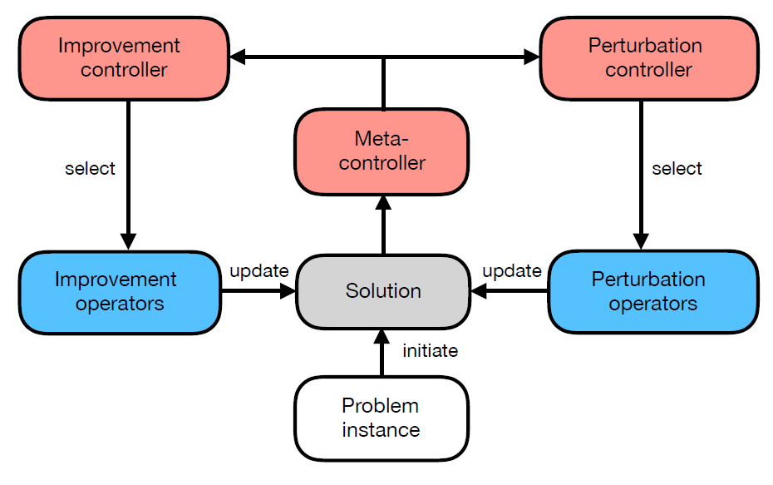
Iterative
hierarchy framework
Policy network
generates a feasible solution.
iteratively updates the solution
with an improvement operator selected by an RL-based controller
with a perturbation operator chosen by a rule-based controller.
choose the best one among all visited solutions.
Hao Lu et al. “A Learning-based Iterative Method for Solving Vehicle Routing Problems”. In ICLR, 2020

Slide 20
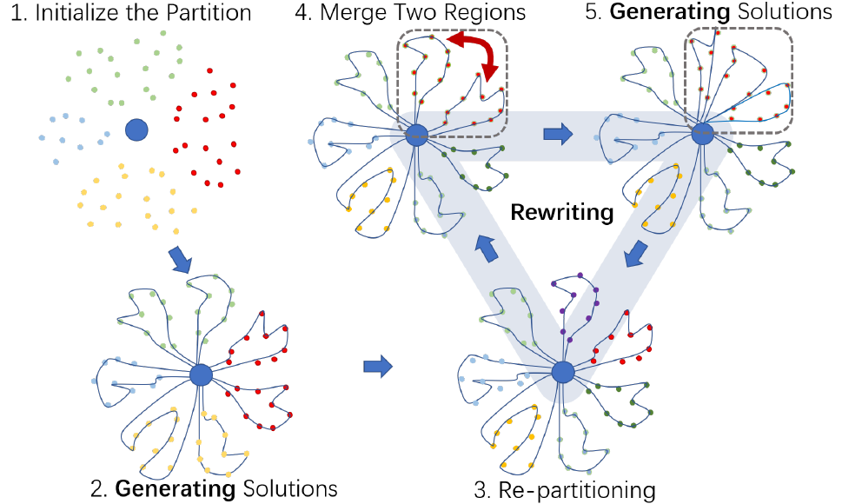
RGB
Rewriting-by-Generating (RBG)
hierarchical RL structure
K-means
a "Generator" and a "Rewriter"
"Generation"
divide customers into regions and use an elementary RL-based VRPs solver to solve them locally
"Rewriting"
based on all regional generations, which rewrites the previous solution with new divisions and the corresponding new regional VRPs results.
Hansen Wang et al. “Learning to Solve Combinatorial Optimization Problems on Real-World Graphs in Linear Time”. arXiv, 2020

Slide 21
RGB
Rewriting-by-Generating (RBG)
hierarchical RL structure
K-means
a "Generator" and a "Rewriter"
"Generation"
REINFORCE for small scale to generate the local optima solution
selecting-merging-repartitioning
"Rewriting"
based on all regional generations, which rewrites the previous solution with new divisions and the corresponding new regional VRPs results.
Hansen Wang et al. “Learning to Solve Combinatorial Optimization Problems on Real-World Graphs in Linear Time”. arXiv, 2020

Slide 22
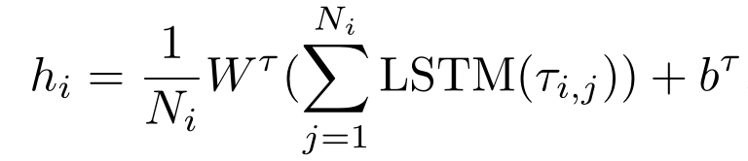
RGB
Rewriting-by-Generating (RBG)
hierarchical RL structure
a "Generator" and a "Rewriter"
"Rewriting"
selecting-merging-repartitioning
Hansen Wang et al. “Learning to Solve Combinatorial Optimization Problems on Real-World Graphs in Linear Time”. arXiv, 2020

Slide 23

Conclusion
Reflection
Capture information from edge features
Integrate node and edge features
Primal Graph & Line Graph
Other ways to solve CO
Regenerate Solution
Branch-and-bound enhanced
Combine with Local Search
Notes:
To conclude, we first model the SFC placement to MDP and employ an intelligent agent to guide SFC requests' online placement decisions. Effective neural network architecture is then leveraged to extract sufficient information from the physical network and SFC requests, integrating GNN and Seq2Seq model. What's more, we utilize the well-known Asynchronous Advantage Actor-critic methods to enhance the training efficiency and model robustness. Additionally, more powerful neural network architectures, more efficient DRL methods and More realistic modelling scenarios are expected to be studied in future.

